Slide 1
Secure Data hiding in images using steganography
CAPSTONE PROJECT
Presented By:
Student Name : Rishav Kumar
College Name & Department : Microtek College of Management
And Technology , BCA Department

Slide 2
Problem Statement
The first Problem statement was the installing the python and It getting error while giving path in vs code. Another problem was the when we were decrypting the image data it was giving some garbage value with the secret Message data. so we added # as unique character to write before entering password for decryption. So that the image will not show garbage value.

Slide 3
OUTLINE
Problem Statement
Technology used
Wow factor
End users
Result
Conclusion
Git-hub Link
Future scope

Slide 4
Technology used
Python
Numpy
Open CV

Slide 5
Wow factors
Our project is all about hiding a text in an image which is called image steganography. The information is hidden in a way that it is not visible to human eye. Steganography is a method of concealing sensitive information by embedding it in an audio, video, image, or text file. It is one of the techniques used to protect confidential or sensitive data from malicious attacks. Image Steganography, as the name implies, is the process of concealing data within an image file. The image chosen for this purpose is referred to as the cover image, and the image obtained after steganography is referred to as the stego image. The primary feature of image steganography is secrecy. The secret information is hidden within the image in a way that is not easily detectable by an unauthorized person.

Slide 6
End users
Ethical hackers.forensics examiners, spies, government security and intelligence agencies also use digital steganography tools and methods. The government carries out secret exchange of messages in the interest of national security using steganography methods as it mitigates the risk of information leakage.

Slide 7
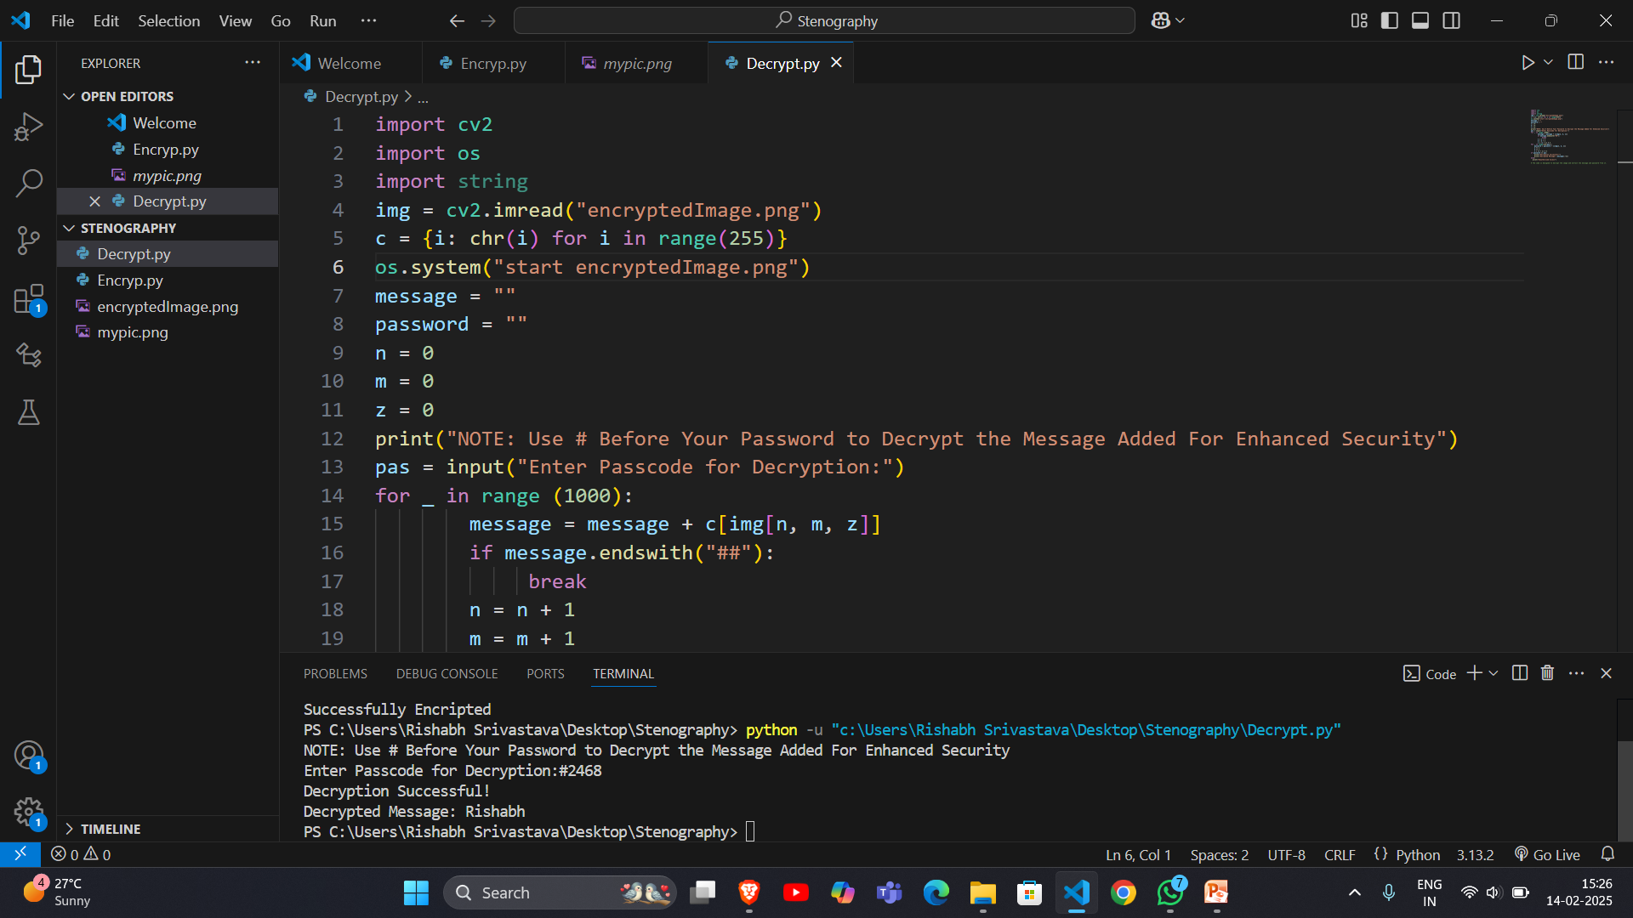
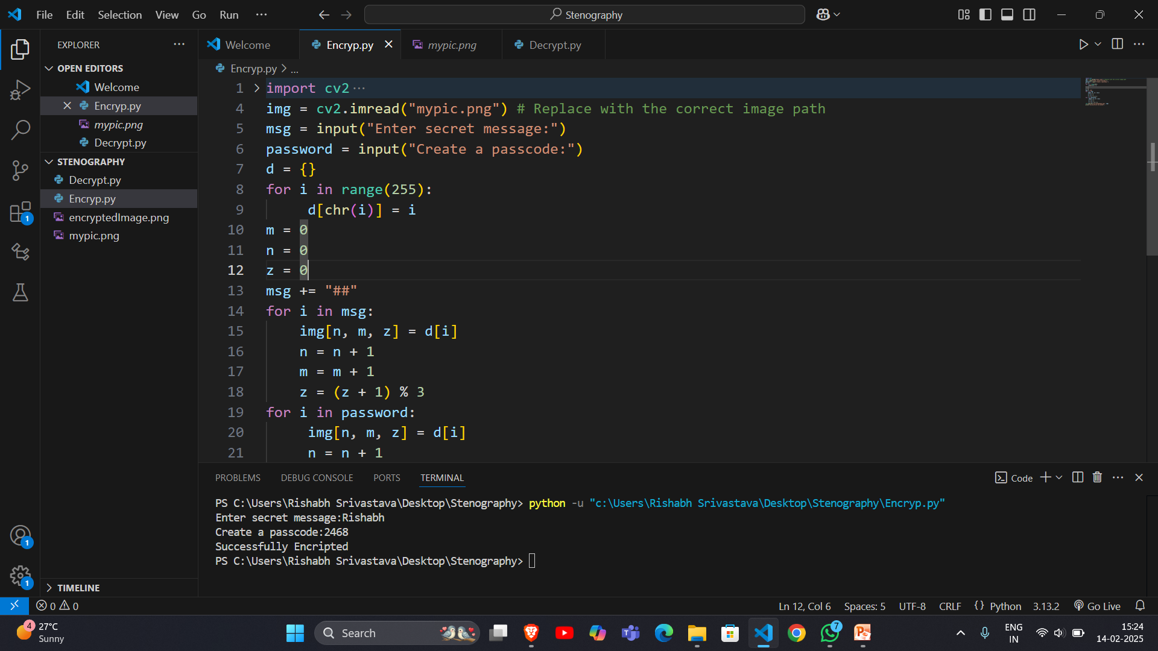

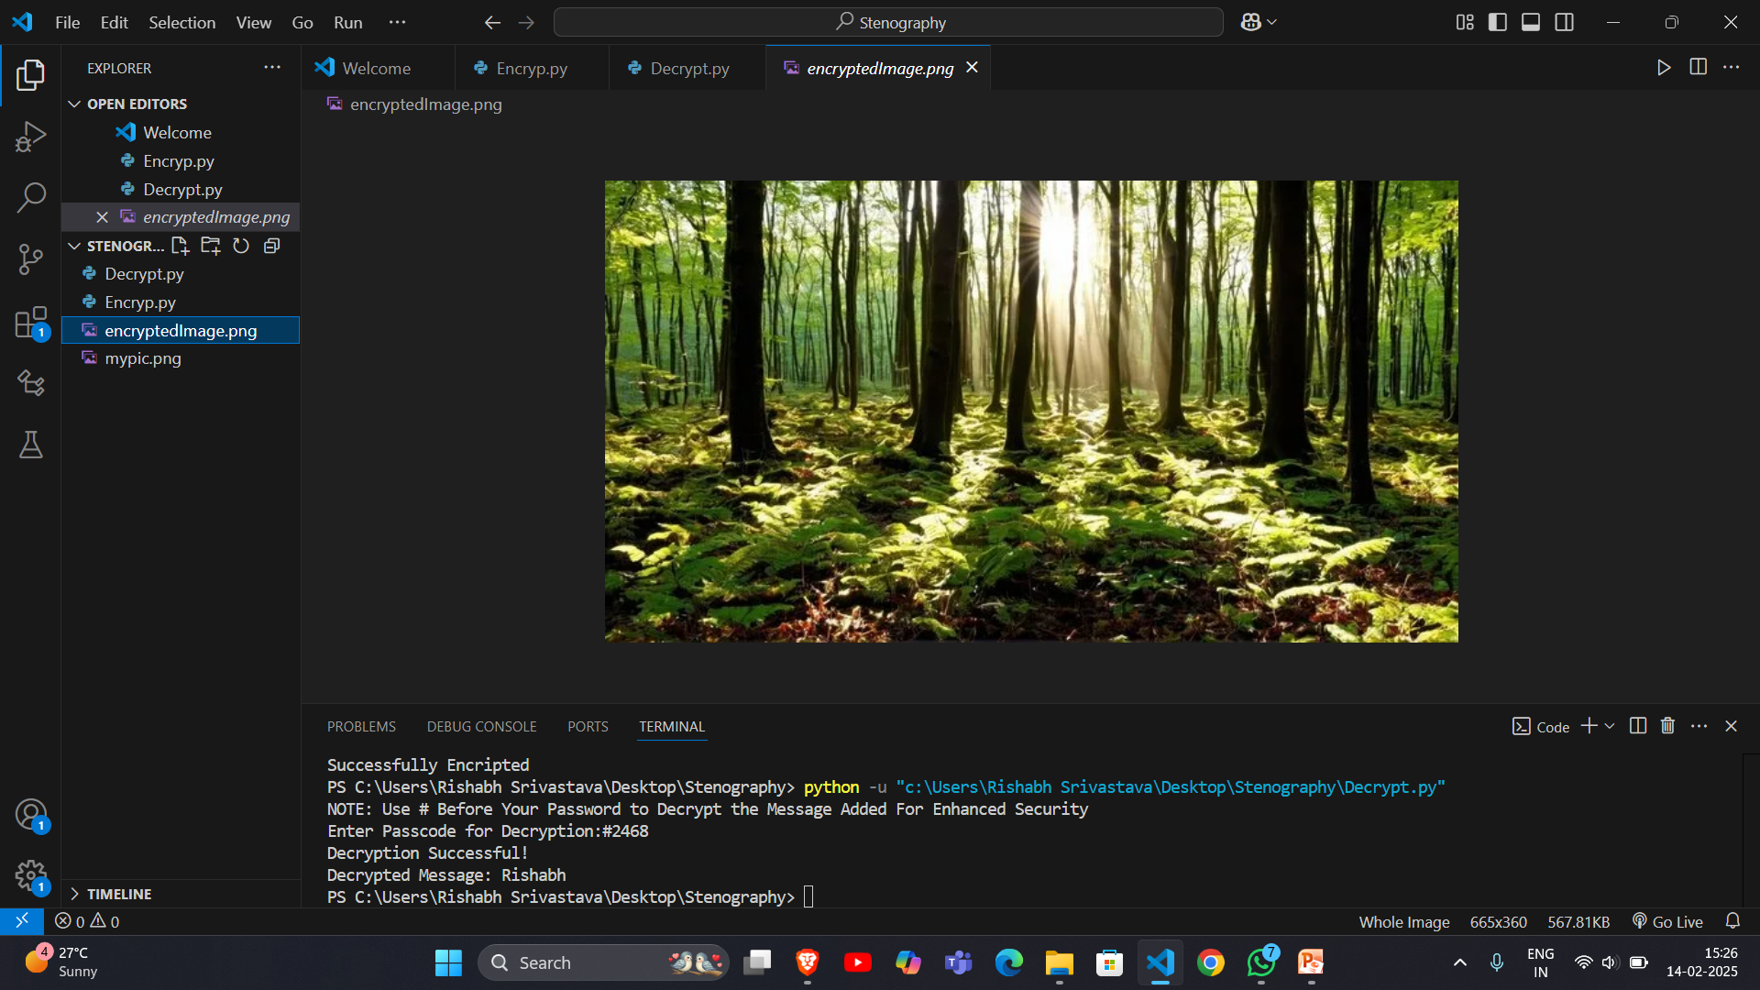
Results

Slide 8
Conclusion
A useful cybersecurity tool
Steganography can help protect sensitive information from intruders.
A covert communication technique
Steganography can be used to transmit sensitive data without being noticed.
A powerful and evolving technique
Steganography is used in many applications, including digital watermarking, copyright protection, and confidential communication.
A technique with trade-offs
Each steganographic implementation has trade-offs, and the steganographer must decide which implementation to use

Slide 9
GitHub Link
https://github.com/Rishav2063/Steganography

Slide 10
Future scope(optional)
Future work can focus on the elaborating steganography in the context of image quality assessment. Also, an advanced encryption algorithm can be investigated to make this work more effective and powerful. Furthermore, to prevent the stego-images from various attacks and improvements to current algorithm, they can be presented in frequency domain.

Slide 11
THANK YOU

